Slide 1
Functional Dependencies

Slide 2
Overview of presentation
1 Base definition
2 Use of Functional Dependencies
3 Trivial and Nontrivial Dependencies
4 Closure of a Set of Dependencies
5 Closure of a Set of Attributes
6 The Cover and Equivalent of FDs
7 Irreducible sets of dependencies
Page <number>

Slide 3
1.Basic Definitions
Let r be a relation, and let X and Y be arbitrary subsets of the set of attributes of r, Y is functionally dependent on X:
X → Y
If and only if each X value in r has associated with it precisely one Y value in r.
Two tuples of r agree on their X value, they also agree on their Y value.
Page <number>

Slide 4
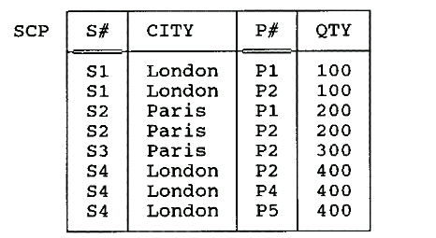
1.Basic Definitions_example
Consider an instance of the revised shipments relation, called SCP:
Some FDs satisfied by SCP:
{S#, P#} → {QTY}
{S#, P#} → {CITY}
{S#, P#} → {CITY, QTY}
{S#, P#} → {S#}
{S#, P#} → {S#, P#, CITY, QTY}
{S#} → {QTY}== S# → QTY
{QTY} → {S#}
Page <number>

Slide 5
1.Basic Definitions…
Let R be a relation variable, and let X and Y be arbitrary subsets of the set of attributes of R. Then we say that Y is functionally dependent on X—in symbols,
X → Y
(read "X functionally determines Y," or simply "X arrow Y")—if and only if, in every possible legal value of R, each X value has associated with it precisely one Y value. In other words, in every possible legal value of R, whenever two tuples agree on their X value, they also agree on their Y value.
Page <number>

Slide 6
1.Basic Definitions_example
Here then are some (time-independent) FDs that apply to relvar SCP:
    {S#, P#} → QTY
    {S#, P#} → CITY
    {S#, P#} → {CITY, QTY}
    {S#, P#} → S#
    {S#, P#} → {S#, P#, CITY, QTY}
    {S#} → CITY
Page <number>

Slide 7
2.Use of Functional Dependencies
Test relations to see if they are legal under a given set of functional dependencies. If a relation r is legal under a set S of functional dependencies, we say that r satisfies S.
Specify constraints on the set of legal relations; we say that S holds on R if all legal relations on R satisfy the set of functional dependencies S.
Note: A specific instance of a relation schema may satisfy a functional dependency even if the functional dependency does not hold on all legal instances.
Page <number>

Slide 8
2.Use of Functional Dependencies…
Even in SCP there is a large number of FDs.
We need a small number of FDs, since they have to be checked at every update by the DBMS.
For a given set S of FDs, find a set T of FDs for which it holds that
  T is smaller than S
  Every FD in S is implied by the FDs in T
And so the DBMS can just check the FDs in T
Partial answer: eliminate trivial dependencies, e.g. SCP
Is there a method for finding T?
Page <number>

Slide 9
3.Trivial and Nontrivial Dependencies
(平凡和非平凡的函数依赖)
One obvious way to reduce the size of the set of FDs we need to deal with is to eliminate the trivial dependencies. A dependency is "trivial" if it cannot possibly not be satisfied.
An FD is trivial if and only if the right-hand side is a subset (not necessarily a proper subset) of the left-hand side
{S#, P#} → {S#}
{S#, P#} → {P#}
As the name implies, trivial dependencies are not very interesting in practice
Page <number>

Slide 10
4.Closure of a Set of Dependencies
Some FDs imply others:
{S#, P#} → {CITY, QTY}
implies both of the following:
{S#, P#} → CITY
{S#, P#} → QTY
The set of all FDs that are implied by a given set S of FDs is called the closure of S, written S⁺.
Page <number>

Slide 11
4.Closure of a Set of Dependencies…
We can find all of S⁺ by applying Armstrong’s Axioms:
  Reflexivity: if B ⊆ A, then A → B (trivial) 自反律
  Augmentation: if A → B , then AC → BC 增广律
  Transitivity: if A → B and B → C, then A → C 传递率
These rules are complete and sound.(完备的,有效的).
  Complete: given a set S of FDs, all FDs implied by S can be derived from S using the rules.
  Sound: no additional FDs can be so derived.
The rules can be used to derive precisely the closure S⁺.
Page <number>

Slide 12
4.Closure of a Set of Dependencies…
Several further rules can be derived from the three given above
  Self-determination: A → A
  Decomposition: If A → BC, then A → B and A → C
  Union: If A → B and A → C , then A → BC
  Composition: If A → B and C → D, then AC → BD
These additional rules can be used to simplify the practical task of computing S⁺ from S.
Page <number>

Slide 13

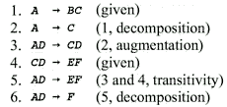
4.Closure of a Set of Dependencies _Example1
Suppose we are given relvar R with attributes A, B, C, D, E, F, and the FDs
Page <number>

Slide 14
4.Closure of a Set of Dependencies _Example2
R = (A, B, C, G, H, I)
S = {A→ B
A→ C
CG→H
CG→I
B → H }
some members of S⁺
  A → H
  AG → I
  CG → HI
Page <number>

Slide 15
5.Closure of a Set of Attributes
In principle, we can compute the closure S⁺ of a given set S of FDs by means of an algorithm that says "Repeatedly apply the rules from the previous section until they stop producing new FDs."
In practice, there is little need to compute the closure per se.
We need to calculate closure Z⁺ of a set of attributes Z, under a set of FDs S.
Page <number>

Slide 16
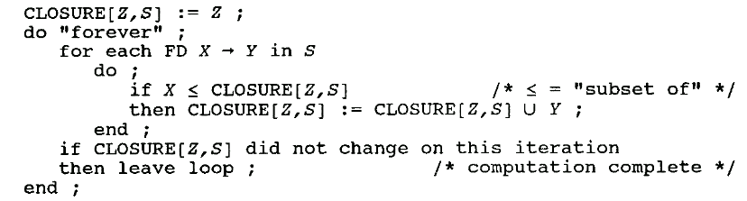
5.Closure of a Set of Attributes…
Given Z and S, determine the set of attributes A which are functionally dependent on Z (i.e. the closure Z⁺ of Z under S).
Algorithm to compute Z⁺, the closure of Z under S:
Page <number>

Slide 17
5.Closure of a Set of Attributes-Example1
Given R with attributes A, B, C, D, E, F and S as:
A → BC
E → CF
B → E
CD → EF
Calculate the closure to {A, B}⁺ of the set
{A, B} under S.
Page <number>

Slide 18
5.Closure of a Set of Attributes-Example1
1. Initialize the result CLOSURE[Z,S] to {A,B}.
2. We now go round the inner loop four times, once for each of the given FDs.
A →BC: CLOSURE[Z,S] is now the set {A,B,C}.
E → CF: unchanged.
B → E: CLOSURE[Z,S] is now the set {A,B,C,E}.
CD → EF: unchanged.
3. Now we go round the inner loop four times again. On the first iteration, the result does not change; on the second, it expands to {A,B,C,E,F}; on the third and fourth, it does not change.
4.Now we go round the inner loop four times again. CLOSURE[Z,S] does not change, and so the whole process terminates, with {A,B}⁺ = {A,B,C,E,F}.
Page <number>

Slide 19
5.Closure of a Set of Attributes-Example2
Given R with attributes A, B, C, D, E and S as:
S={AB→C，BC→AD，D→E，CF→B}， Calculate the closure to {A, B}⁺ of the set
{A, B} under S.
①{A,B}⁺ = {A,B}
② AB→C {A,B}⁺ = {A,B,C}
③ BC→AD {A,B}⁺ = {A,B,C,D}
④ D→E {A,B}⁺ = {A,B,C,D,E}
⑤ 结果： {A,B}⁺= {A,B,C,D,E}
Page <number>

Slide 20
5.Closure of a Set of Attributes -
Important Corollaries
The FD X → Y will follows from S if and only if Y is a subset of the closure X⁺ of X under S.
K is a superkey if and only if the closure K⁺ of K is precisely the set of all attributes.
Page <number>

Slide 21
5.Closure of a Set of Attributes-Example3
R = (A, B, C, G, H, I)
S = {A→ B
A → C
CG→H
CG→I
B → H}
(AG) ⁺ = ABCGHI
Is AG a candidate key?
Page <number>

Slide 22
5.Closure of a Set of Attributes-Example4
relvar{A,B,C,D,E,F,G}satisfies the following FDs
A→B
BC→DE
AEF→G
the closure of {A,C}? ACF→DG ?
Answer: {ABCDE} Yes
Page <number>

Slide 23
6.The Cover and Equivalent of FDs
Given two sets of FDs S1 and S2, if every FD implied by S1 is implied by the FDs in S2 (i.e. if S1⁺ is a subset of S2⁺) then S2 is a cover for S1 (i.e. the DBMS only has to check S2).
  If the DBMS enforce the FDs in S2, then it will automatically be enforcing the FDs in S1.
If S2 is a cover for S1 and S1 is a cover for S2,
i.e., if S1⁺=S2⁺, we say S1 and S2 are equivalent.
If S1 and S2 are equivalent, then if the DBMS enforce the FDs in S2, it will automatically be enforcing the FDs in S1, and vice versa.
Page <number>

Slide 24
7.Irreducible sets of dependencies
(最小函数依赖集)
A set of FDs S is irreducible if and only if
  The right-hand side of each FD in S involves one attribute.
  No attribute in the left-hand side of each FD in S can be removed without changing S⁺.
  No FD in S can be removed without changing S⁺.
For every set of FDs, there exists at least one equivalent set that is irreducible.
Page <number>

Slide 25

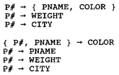

7.Irreducible sets of dependencies-example1
This set of FDs is easily seen to be irreducible:
  The right-hand side is a single attribute in each case
  The left-hand side is obviously irreducible in turn
  None of the FDs can be discarded without changing the closure (i.e., without losing some information).
the following sets of FDs are not irreducible
Page <number>

Slide 26
7.Irreducible sets of dependencies…
A set I of FDs that is irreducible and equivalent to some other set S of FDs is said to be an irreducible equivalent to S.
Given some particular set S of FDs that need to be enforced, it is sufficient for the system to find and enforce the FDs in an irreducible equivalent I instead.
A given set of FDs does not necessarily have a unique irreducible equivalent.
Page <number>

Slide 27
7.Irreducible sets of dependencies_Example 2
R = (A, B, C, D)
S = {A → BC
B→ C
A → B
AB → C
AC → D}
the irreducible set
A → B
B → C
A → D
Rewrite the FDs such that each has a singleton right-hand side:
  A→ B
  A→ C
B→ C
A→ B
AB→ C
AC→ D
attribute C can be eliminated from the left-hand side of the FD AC→ D
Because A→ C A→AC A→D
3 FD AB→C can be eliminated
Because AB→BC AB→C
4 the FD A→C is implied by the FDs A→B and B→C, so it can also be eliminated.
Page <number>

Slide 28
7.Irreducible sets of dependencies_Example 3
Are the two following FDs equivalent?
1） A→B AB→C D→AC D→E
A→BC D→AE
The first is equivalent to the following irreducible set:
A→B AB→C D→A D→C D→E
A→AB AB→C SO A→C SO instead of AB→C using A→C
D→A A→C SO eliminate D→C
SO A→B A→C D→A D→E
Page <number>

Slide 29
Exercises
R = (A, B, C, D)
S = O
the candidate key?
answer: {A B C D}
2) R=(A,B,C)
  S=A→B, B→C
  S⁺=？
  answer: Many
Page <number>

Slide 30
Example
3) R=(A, B, C, D, E)
S ={AB→C, CD→A,BC→D,D→B,EA→C}
{ABE}⁺=？
4) R=(A, B, C, D, E)
S ={A→B, B→D,CE→A,CD→E}
AC→BE ?
the candidate key?
Answer: A→D AC→CD AC→E AC→BE
Relation variable R{A,B,C,D,E,F,G}satisfies the following FDs FD={A→B, BC→DE, AC-->B, AEF→G, AC-->DE}， the irreducible equivalent set of FD.?
AEF→G A→B BC→D BC→E
Page <number>
Notes:
两个函数依赖集F和G等价的充分必要条件是什么？
提示：证明 F中每个FD在G⁺ 中 ，并且G中每个FD也在F⁺ 中 。

Slide 31

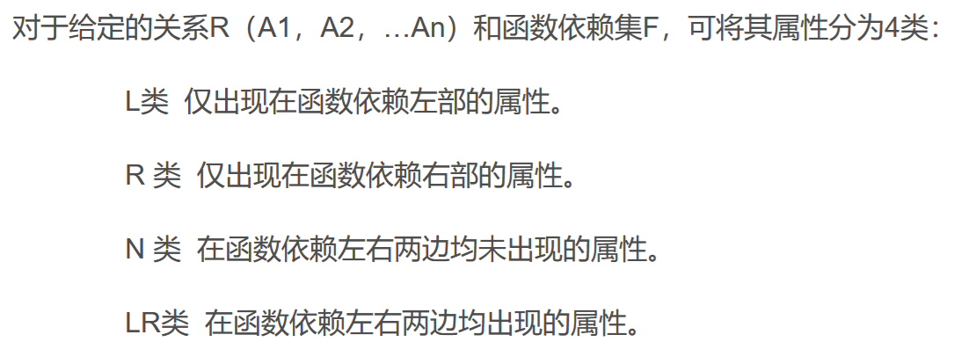
补充
Page <number>

Slide 32

Page <number>

Slide 33


Page <number>

Slide 34
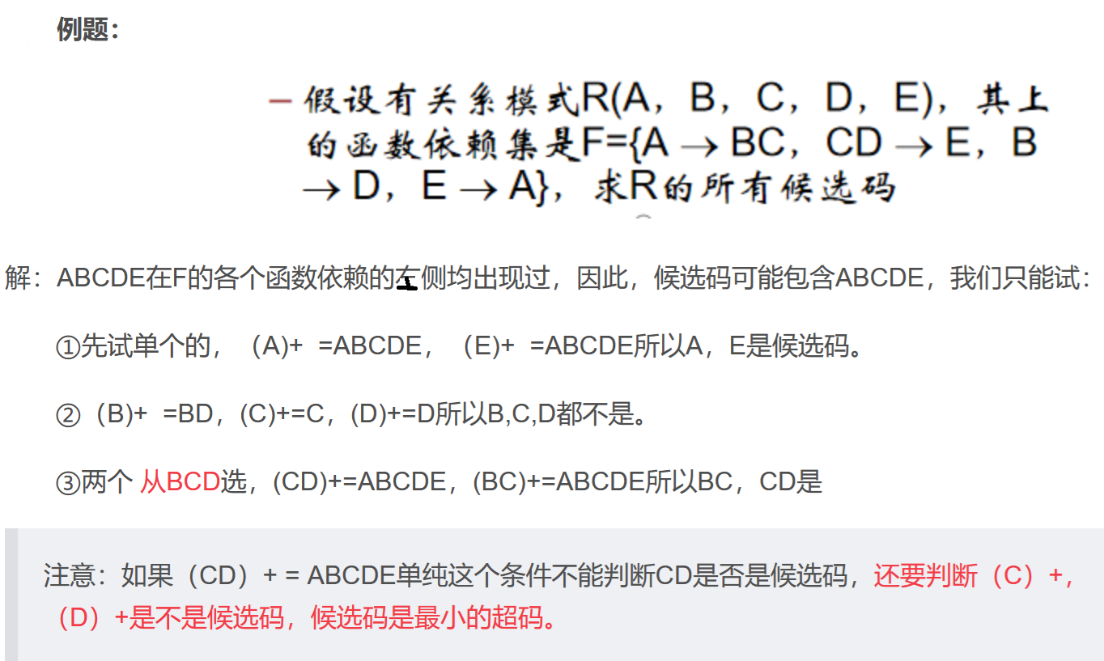
Page <number>

Slide 35
设有关系模式R(A，B，C，D，E，F), 其函数依赖集为： F={E→D，C→B，CE→F，B→A}。指出 R 的所有候选码并说明原因；
回答：候选码就是主码，即可以作为决定性因素的属性，候选码可以 → 所有的值，通俗地讲就是只能出现在箭头的前面，不能出现在后面。
那这里A、B、D、F四个属性肯定是不行了，只有 C和E了，发现 CE 之间没有依赖关系，并且CE→ABCDEF，所以CE就是候选码。
Page <number>

